Slide 1
INFO 6210: Data Mgmt & Database Design Blood Bank Management System Team 27 Gaurao Thakur Chetan Shirsath

Slide 2
Project Details
Mission Statement:
This project will serve the purpose to develop the database for Blood Bank Management
System. It will help to facilitate day to day tasks of various blood banks and associated health
clinics. This database will be useful for donors, blood banks and hospitals.
Business Problems Addressed:
This database system allows to manage blood inventories to tackle the emergency
Situations. It allows hospitals to request the blood units within no time in critical situations by
checking the blood availability in blood banks.
It will help the blood bank to determine the reports about the following information:
Amount of blood donated according to blood type.
Amount of blood requested by hospitals.
Information can be used to estimate the amount of a particular blood type that is available.

Slide 3
Design Details
Database Entity Details(Key Design Decisions):
Below are some of the main entity types of this database with brief description.
BLOOD BANK: It is where blood bank inventory is present.
BLOOD CAMPS: Details about the camps where donors will donate the blood.
DONOR: The one who volunteers to donate the blood.
HOSPITALS: Who will put the requests for blood to the blood banks.
PATIENT: Details of the patients in the hospital.
STAFF: The one who works at the blood bank.
STAFF CATEGORY: Categories of the staff e.g., nurse, technicians.
BLOOD REQUEST: Details of the donation request. Request can be made by an
employee who belongs to a particular hospital or clinic.
DONATIONS: Details of the donation made by the donors.
MEDICAL CONDITION: Medical condition of the donor.
MEDICATION: Medication details of the donor.
ADDRESS: Details of the address of each physical entity.

Slide 4
Design Details
Entity Relations:
BLOOD BANK: Will be related to entities Blood Request,Blood Camps, Donors, Staff by
adding primary key as a foreign key.Hospitals can send multiple request to bank.
BLOOD CAMPS: Bank can arrange multiple donation camps, related by blood bank id.
DONOR: Multiple donors are also associated with blood bank and related using blood
bank id.
HOSPITALS: Hospitals can raise multiple blood requests. Related to blood request with
hospital id. Hospital can have multiple patients. Related to patients with hospital id.
PATIENT: Patient will be related to hospital using hospital id. Patient will have his own
address.
STAFF: Staff will have categories and related to staff category. Staff will be related to
bank using bank id.

Slide 5
Design Details
STAFF CATEGORY: Staff category will be related to staff table using category id.
BLOOD REQUEST: Hospitals can raise multiple blood requests and related using
hospital id. And also related to blood bank using blood bank id.
DONATIONS: Multiple donations can be done by donor as related using donor id as a
foreign key.
MEDICAL CONDITION: It will be related to donor using the table
DONORS_MEDICAL_CONDITION. Both tables will be connected using donor id and
condition id as a foreign keys.
MEDICATION: It will be connected to donor in a table using donor id and medication id
as foreign keys.
ADDRESS: Each Physical entity will have address. Hospital, donor, blood bank will have
address id in the table as a foreign key.

Slide 6
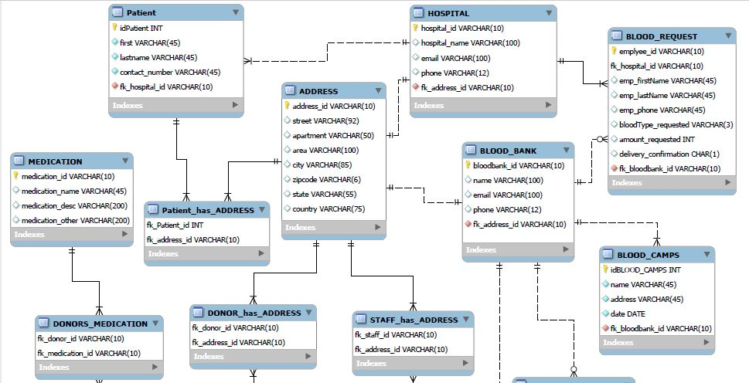
ERD Document

Slide 7
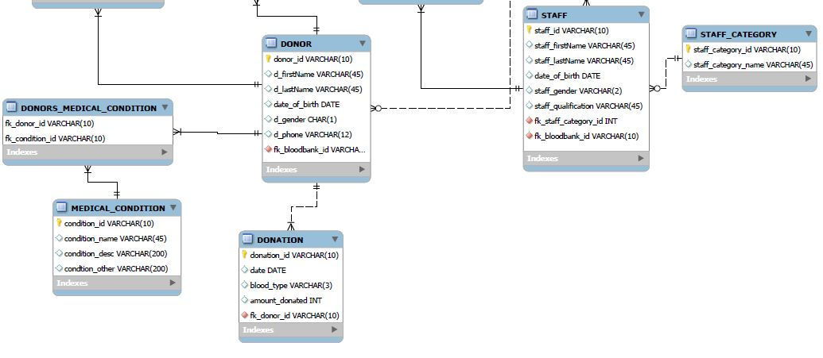
ERD Document

Slide 8
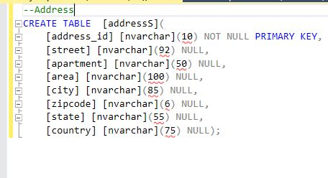
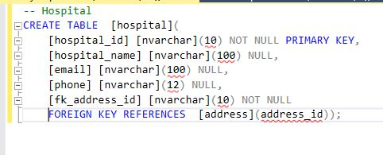
Database Implementation

Slide 9
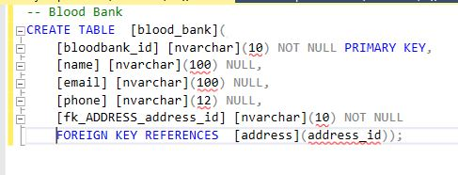
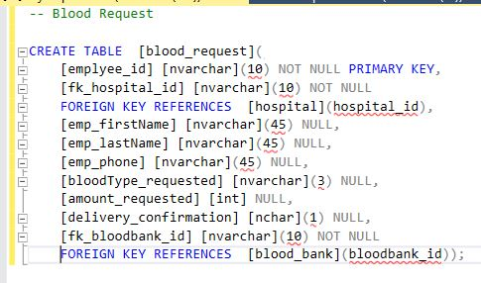
Database Implementation

Slide 10
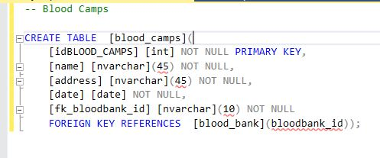
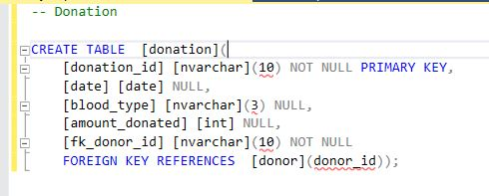
Database Implementation

Slide 11
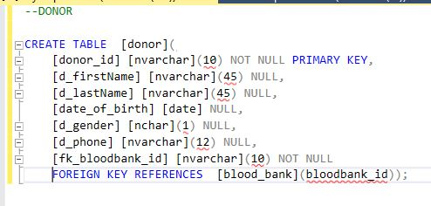
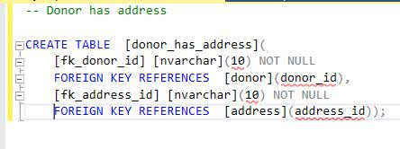
Database Implementation

Slide 12
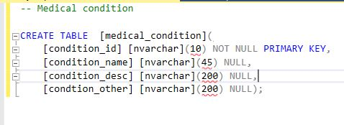
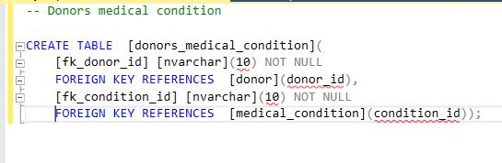
Database Implementation

Slide 13
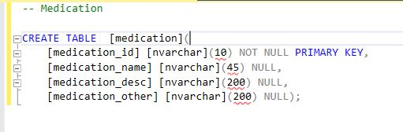
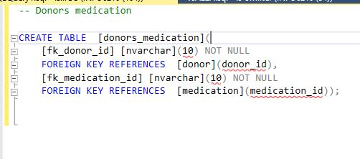
Database Implementation

Slide 14
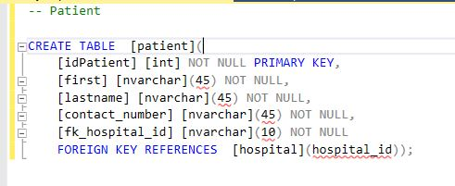
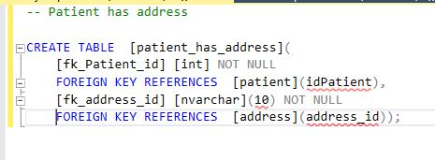
Database Implementation

Slide 15
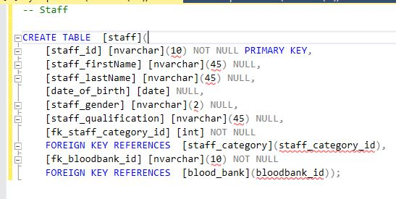
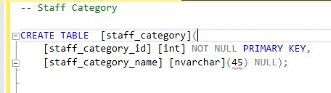
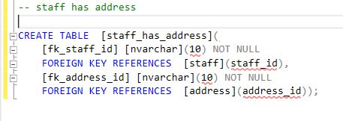
Database Implementation

Slide 16
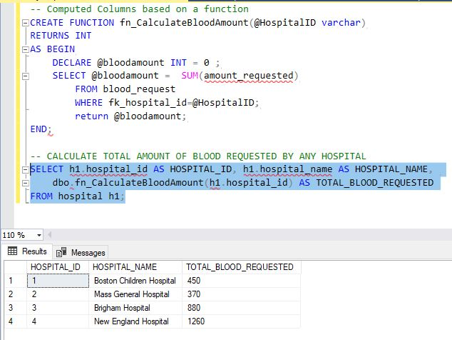
Functions

Slide 17
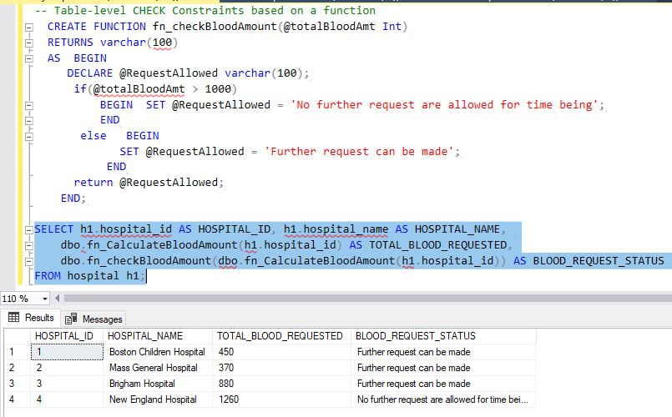
Functions

Slide 18
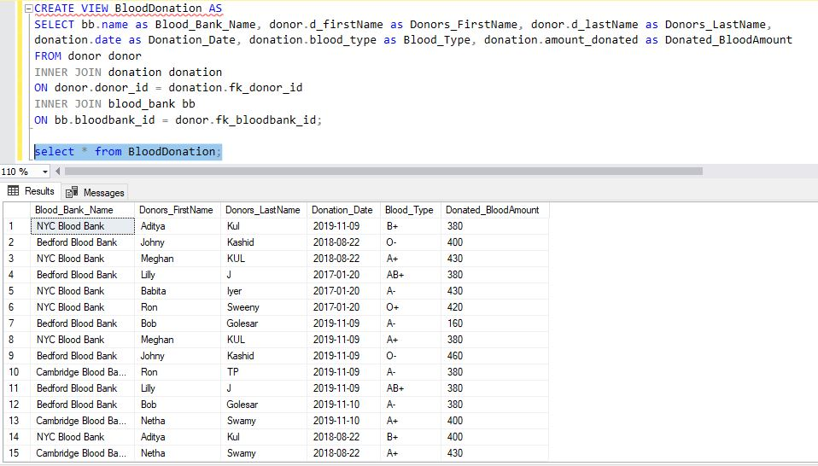
Views

Slide 19
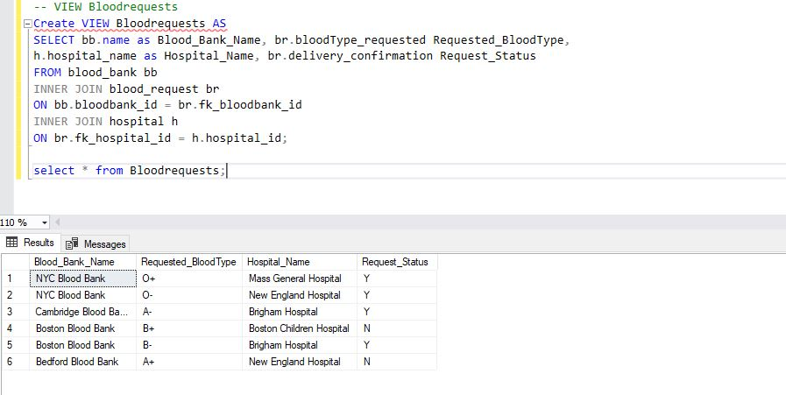
Views

Slide 20
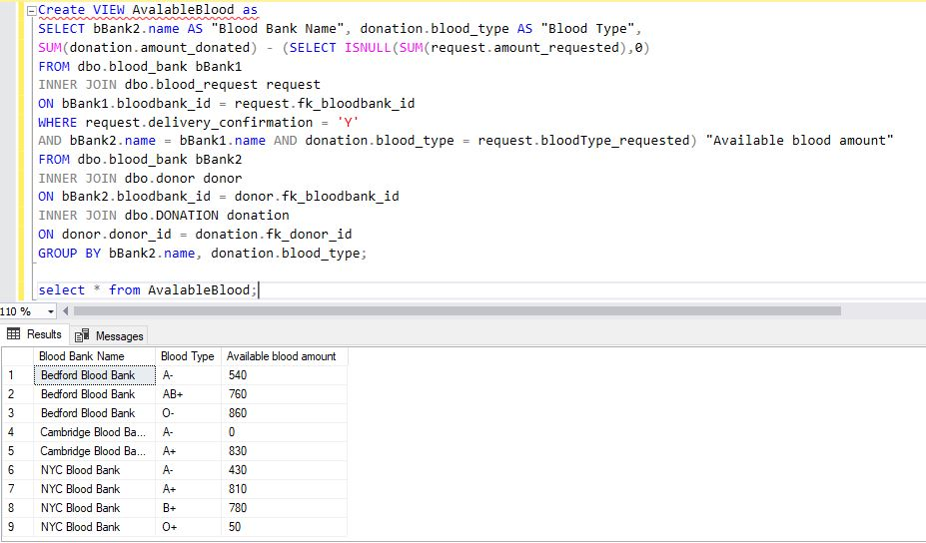
Views

Slide 21
Reports and Visualization
Donated Blood Amount
Requested Blood Amount
Available Blood Amount

Slide 22
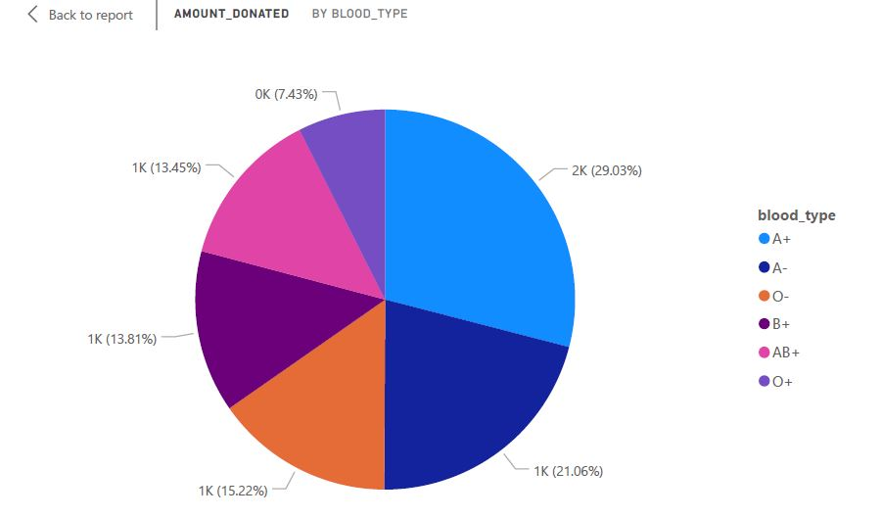
AMOUNT DONATED BY DONORS

Slide 23
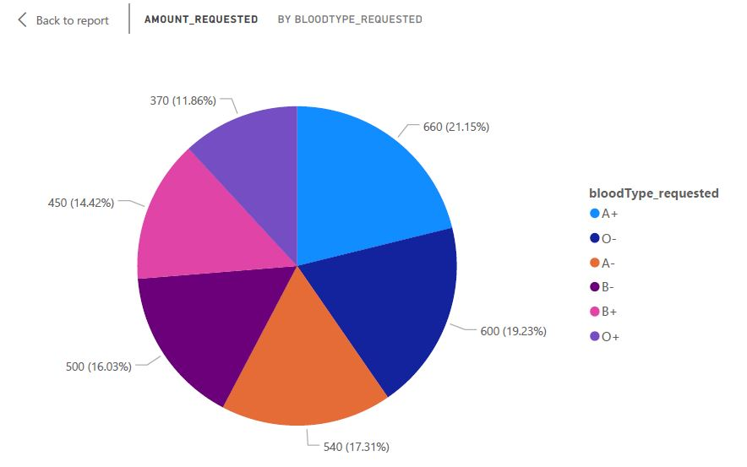
AMOUNT REQUESTED

Slide 24
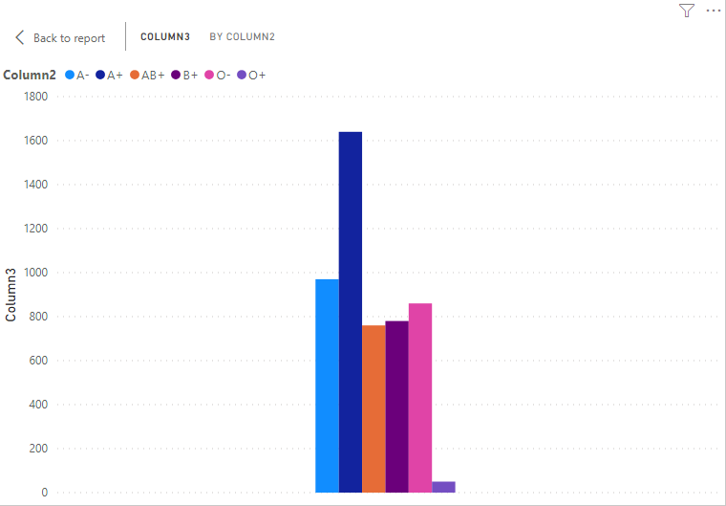
Available Blood Amount

Slide 25
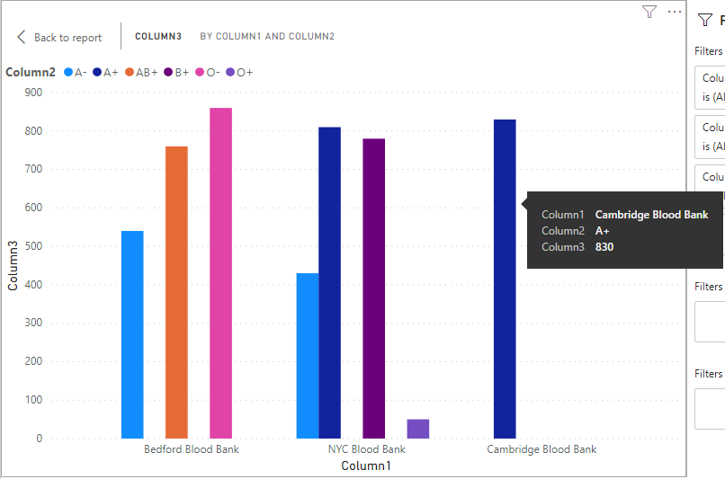
Available Blood Amount by Blood Bank

Slide 26
Q & A

Slide 27
Thank you

